Slide 1


Slide 2
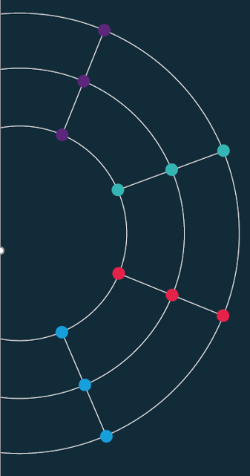
Session 5. Data scraping
[60 min]
Scraping the HTML source
[30 min]

Slide 3
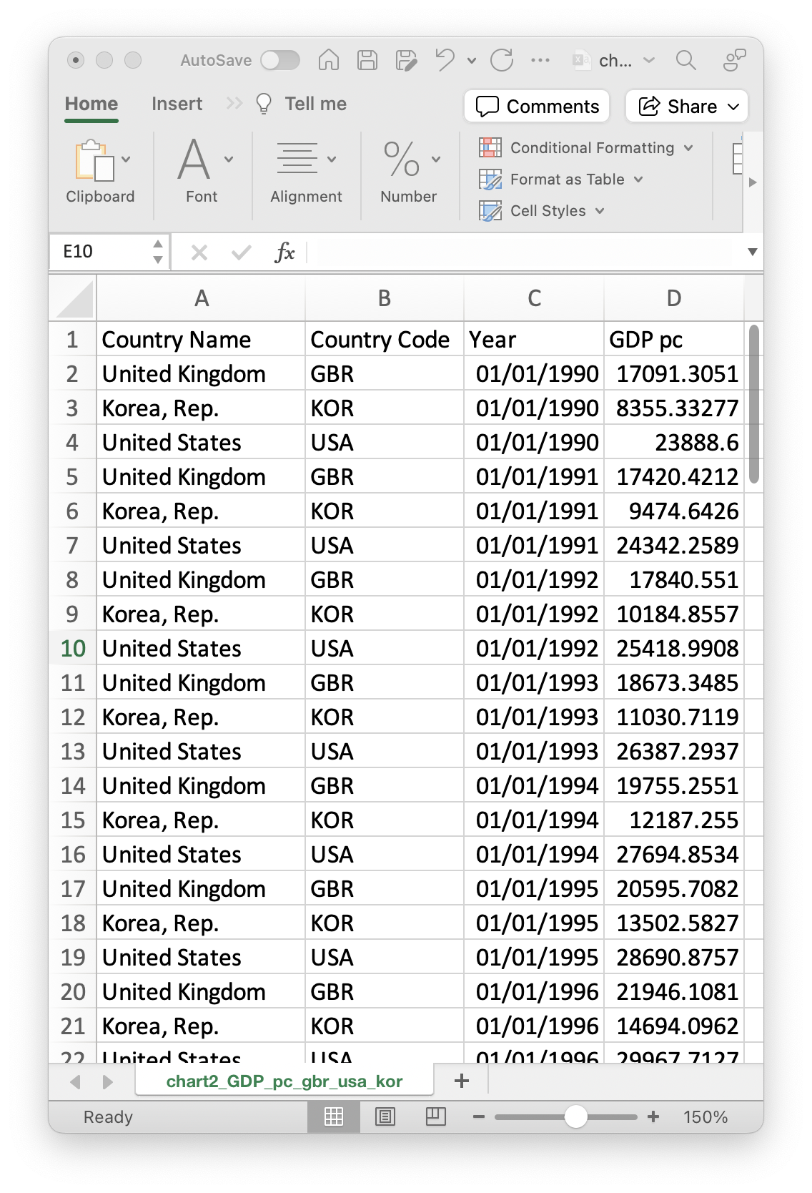
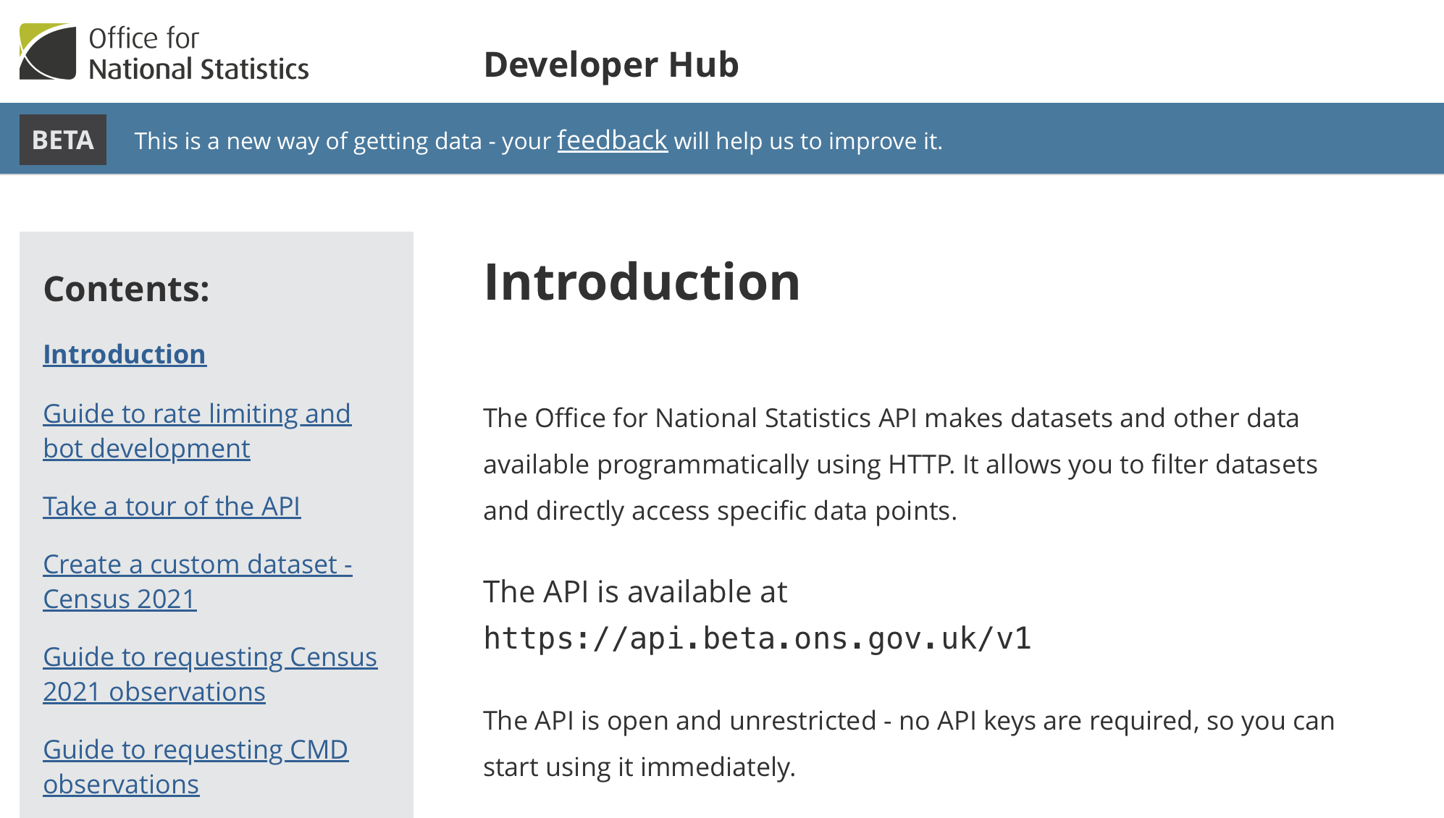
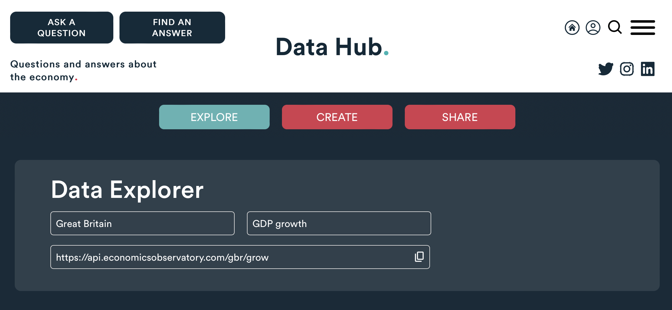
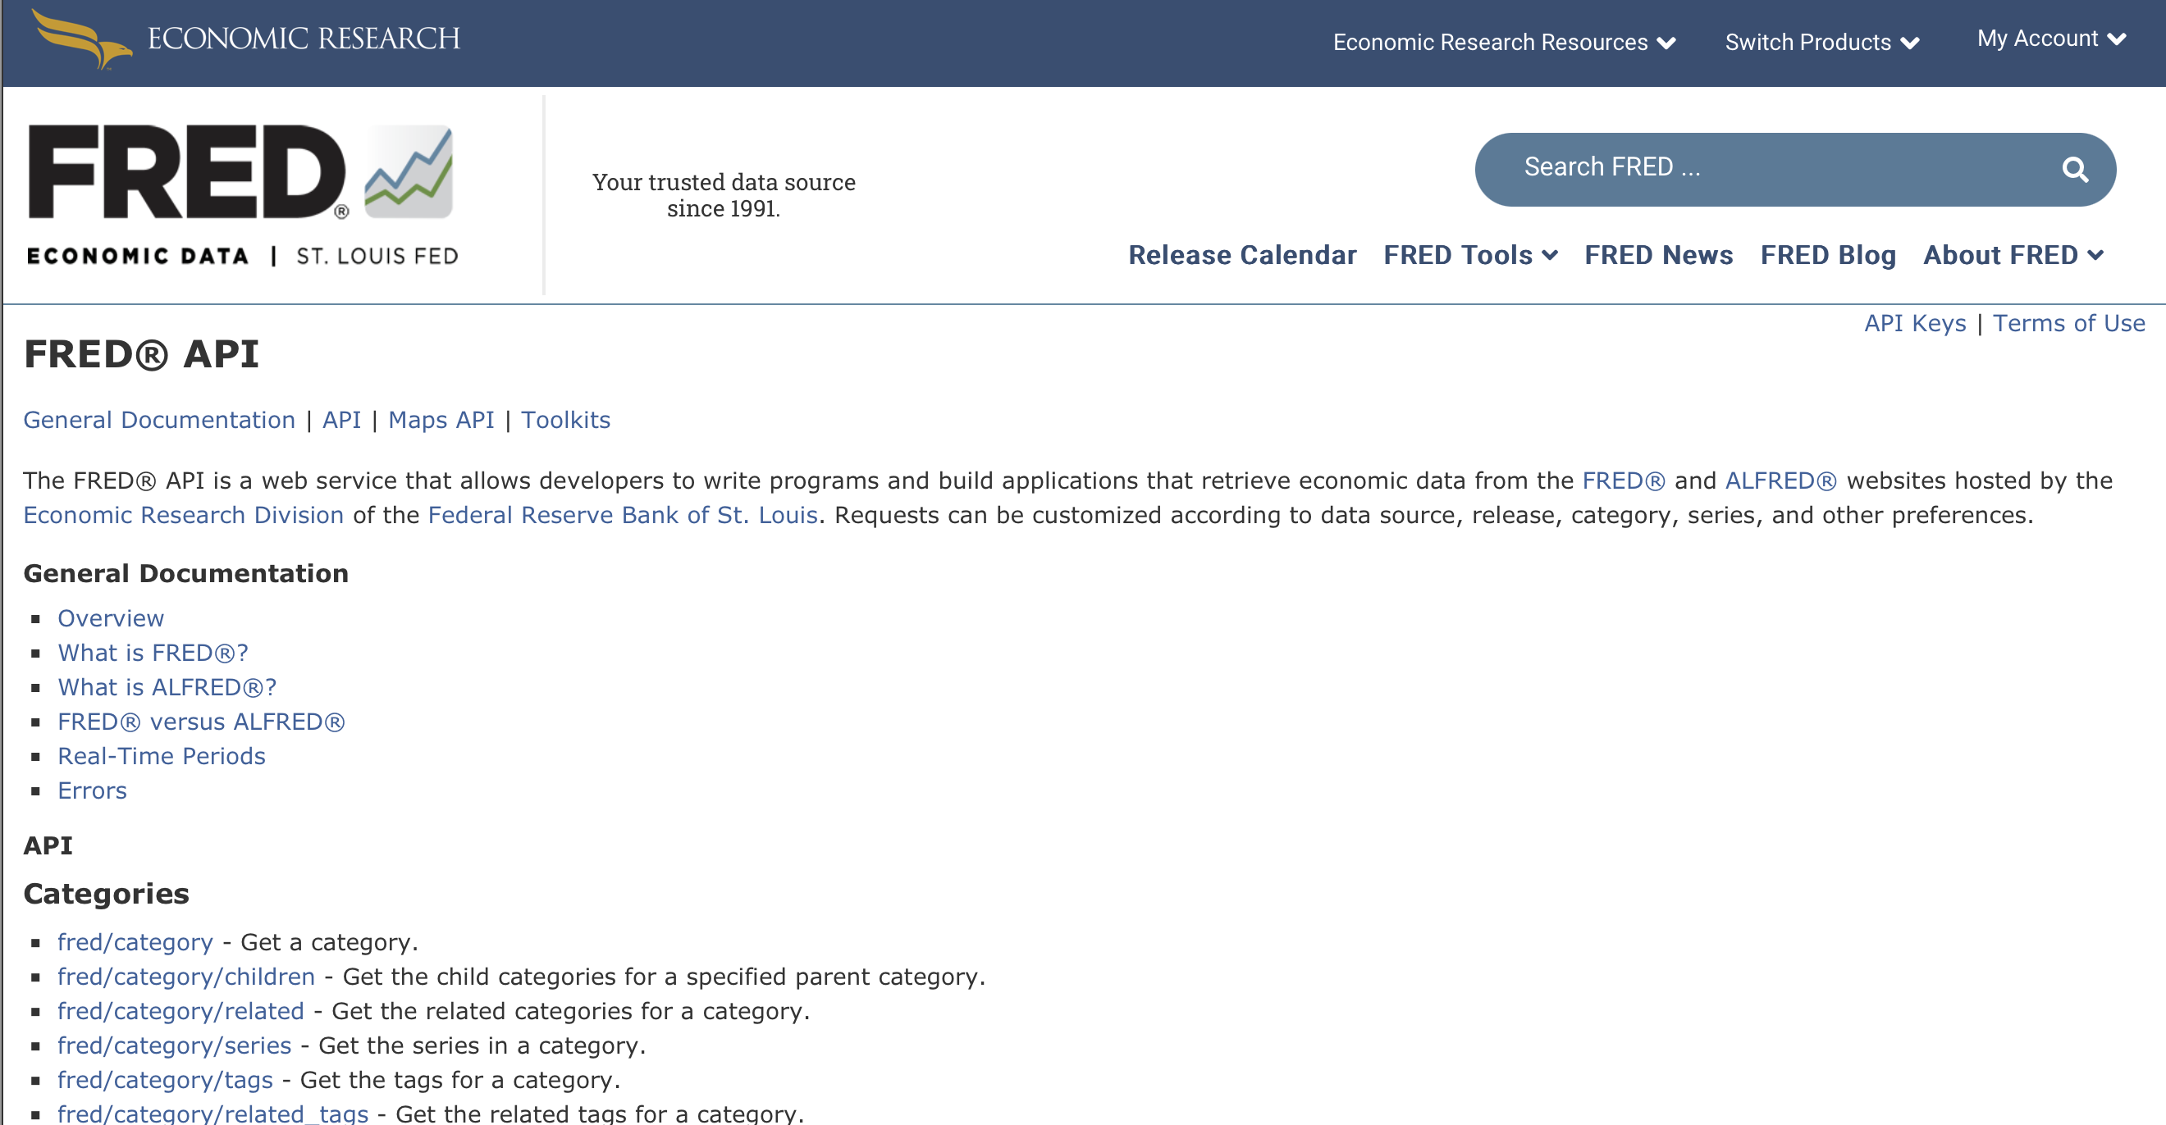
Data, so far ...
Today, we have used data from
Structured Files
(e.g. Excel, CSV, JSON)
APIs
(e.g. ONS, ECO, FRED)
But what do we do when the data we want isn’t available?

Slide 4
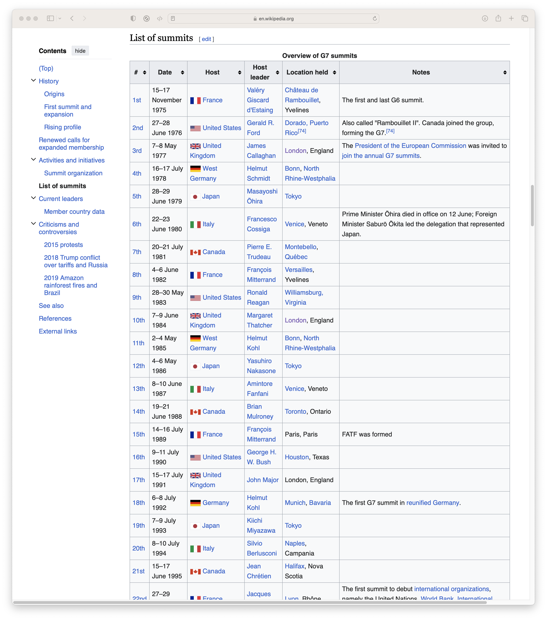
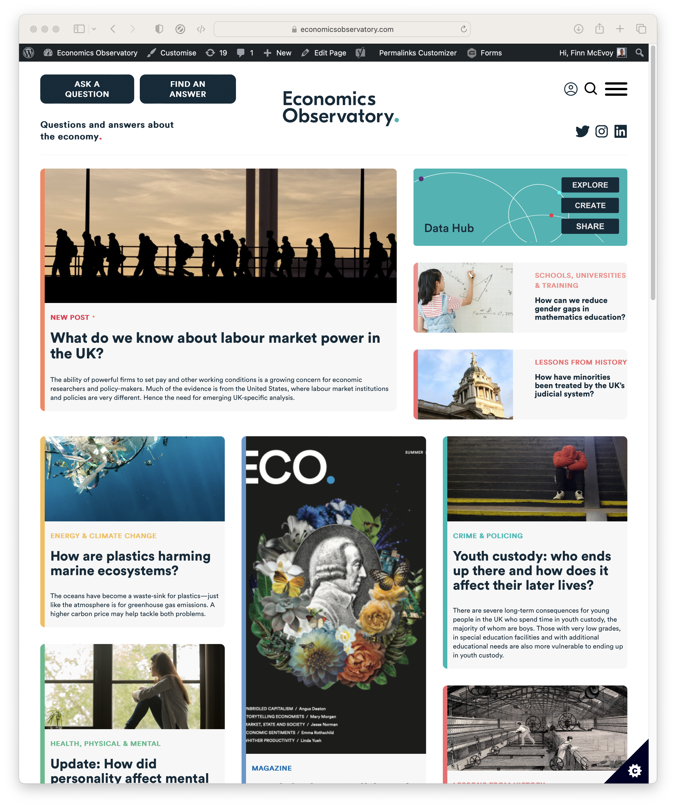
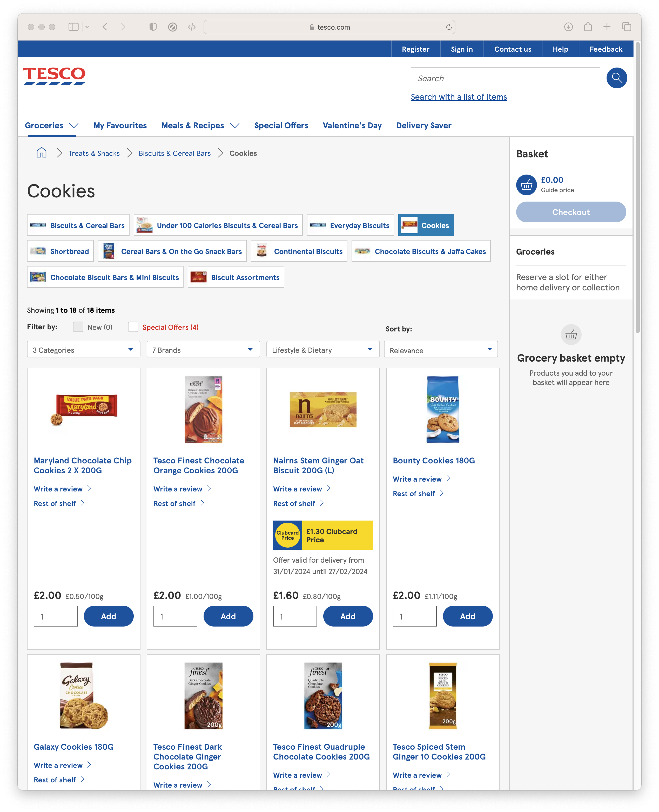
Data, so far ...
What if we want
Data from Wikipedia
News and Media
Prices from Supermarkets

Slide 5
Scraping.
The automated extraction of data from websites
Scraping the HTML source. Easy. Automated.
Scraping static HTML pages.
A bit more difficult. Can be automated.
CAPTCHA. Impersonating a human user. Zombie browser.
Scraping HTML pages generated on-the-fly with JavaScript.
Hard. Only zombie browser works, and only in some cases.
hiQ labs vs. LinkedIn, 2019, US Court of Appeals for the Ninth Circuit, 17-16783
LinkedIn vs. hiQ labs, 2021, US Supreme Court, 19-1116

Slide 6
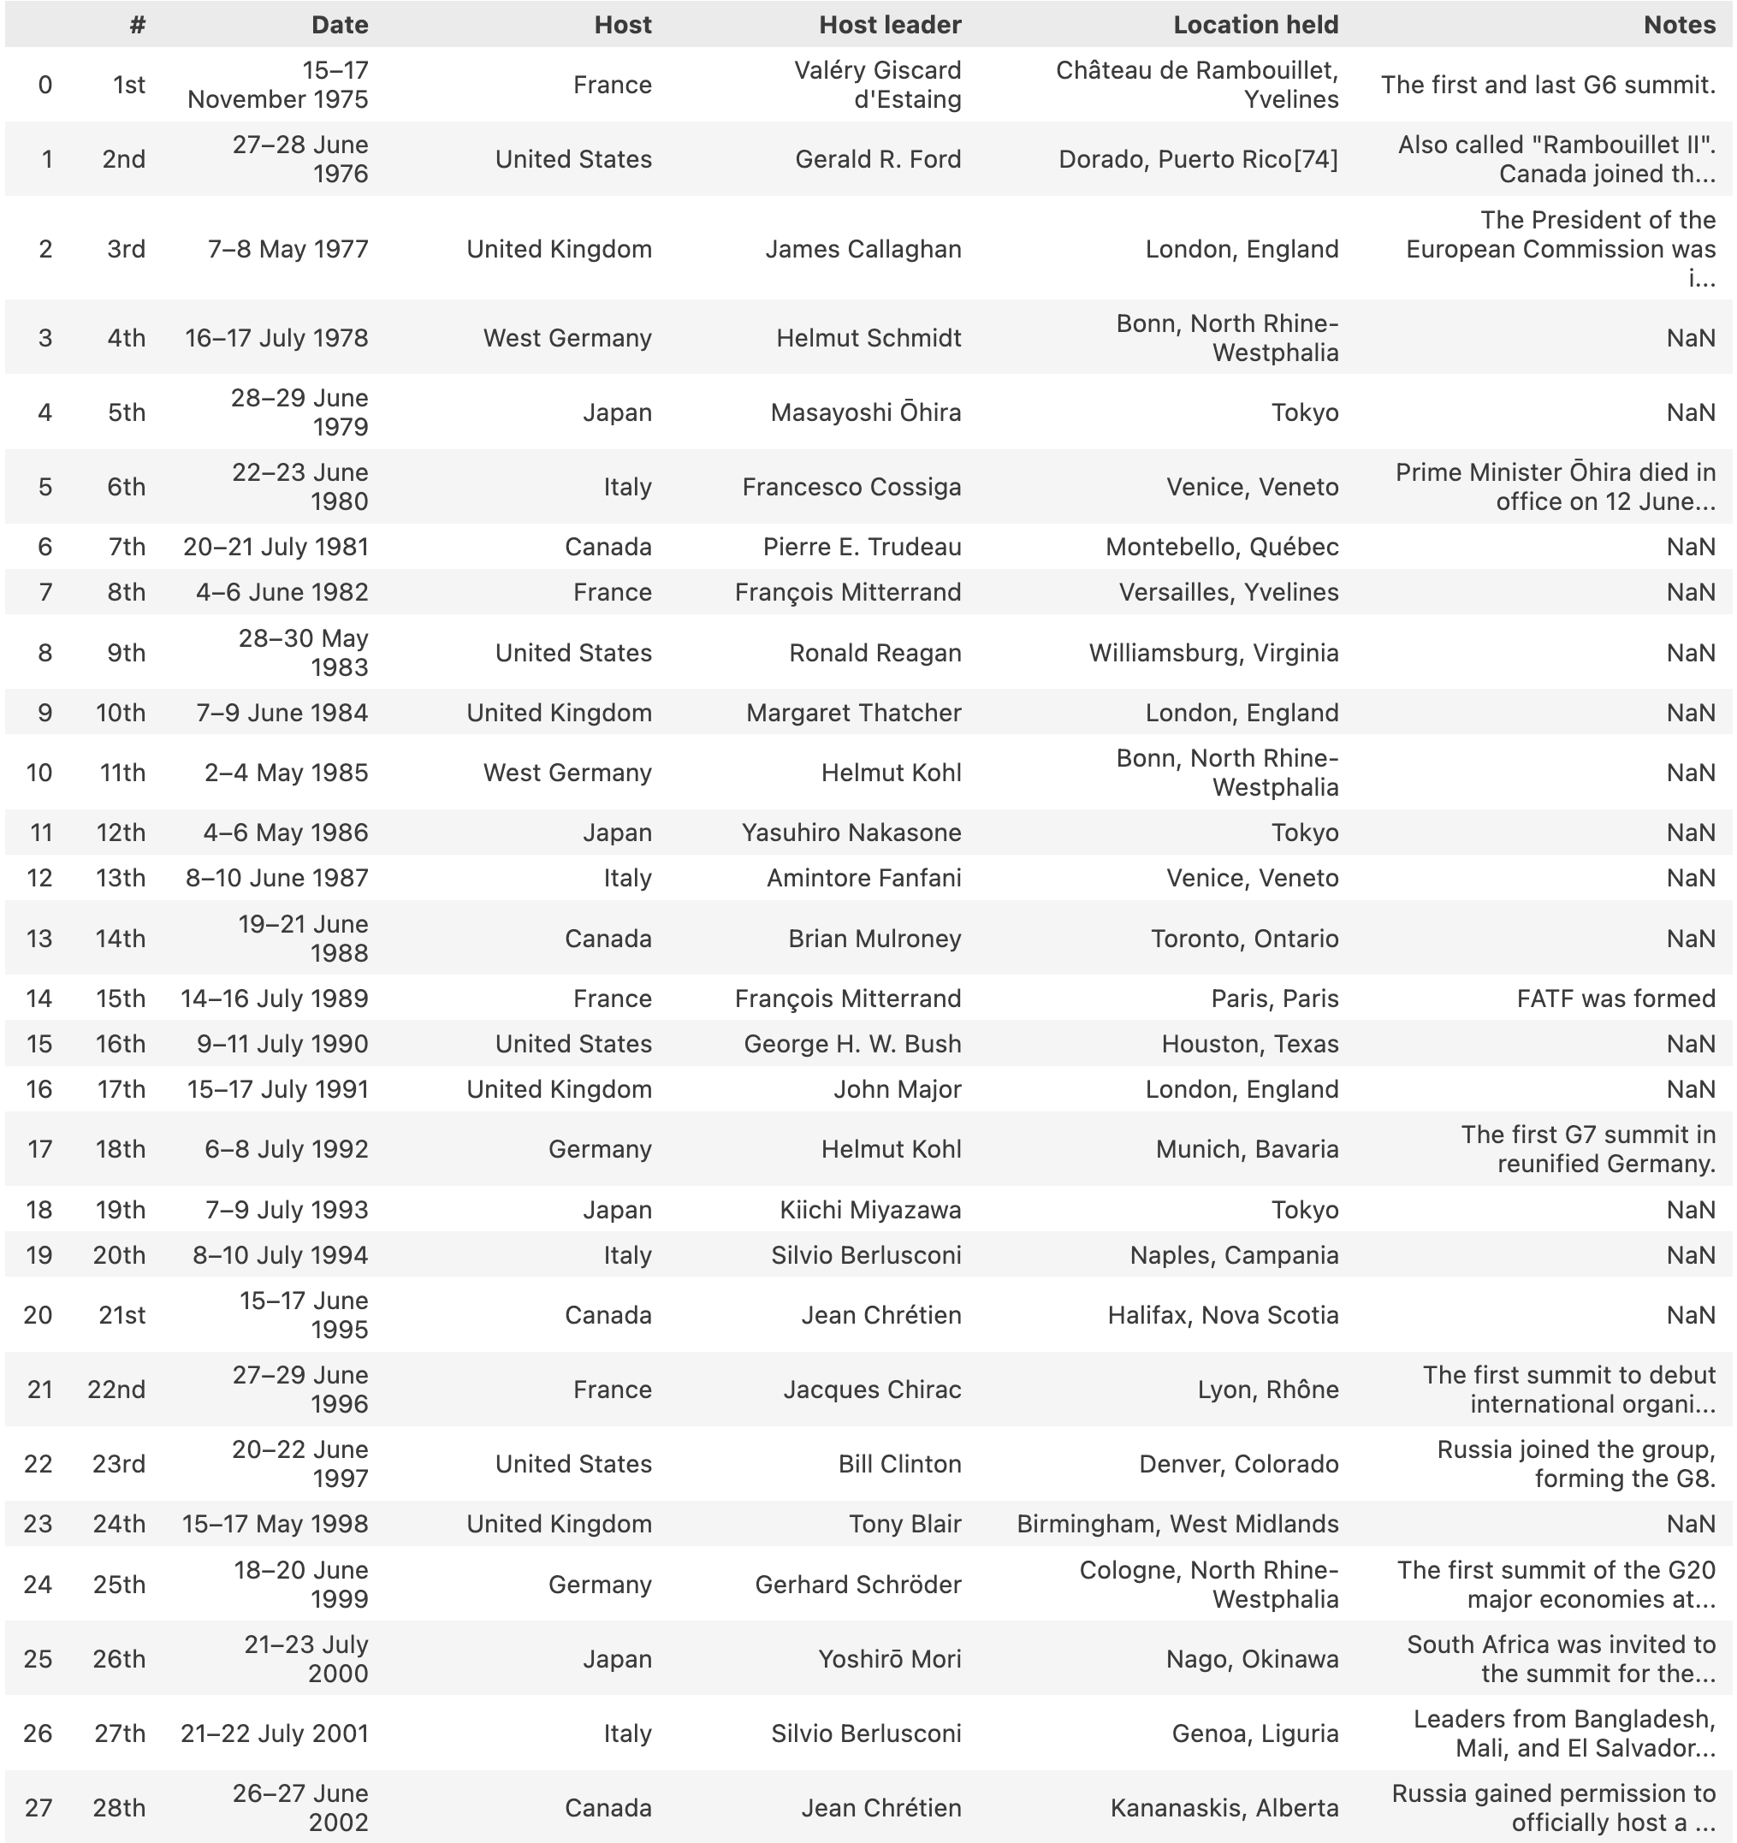
Today we will.
1. Extract data from Wikipedia
Notes:
We’re primarily going to scrape Wikipedia today

Slide 7
Today we will.
2. Take a quick look at more complicated scraping
3. Share the tools to learn more
Notes:
But you’ll also leave with a demonstration of tools you can use to learn more.
Today intended to spark an interest.

Slide 8
Overview.
1. Identify the data needed
2. Look Around – do you need to scrape?
3. Scrape the data
4. Cleaning and Visualising

Slide 9
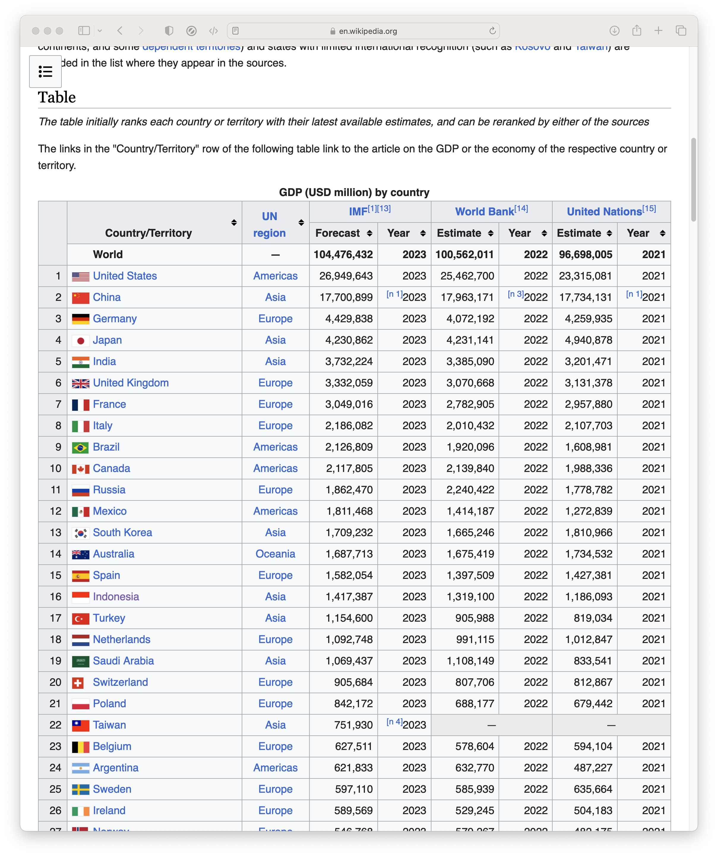
Identify the data needed.
You can scrape almost anything
… but scraping is most useful for hard-to-find data
You could scrape Wikipedia’s list of countries by GDP…

Slide 10
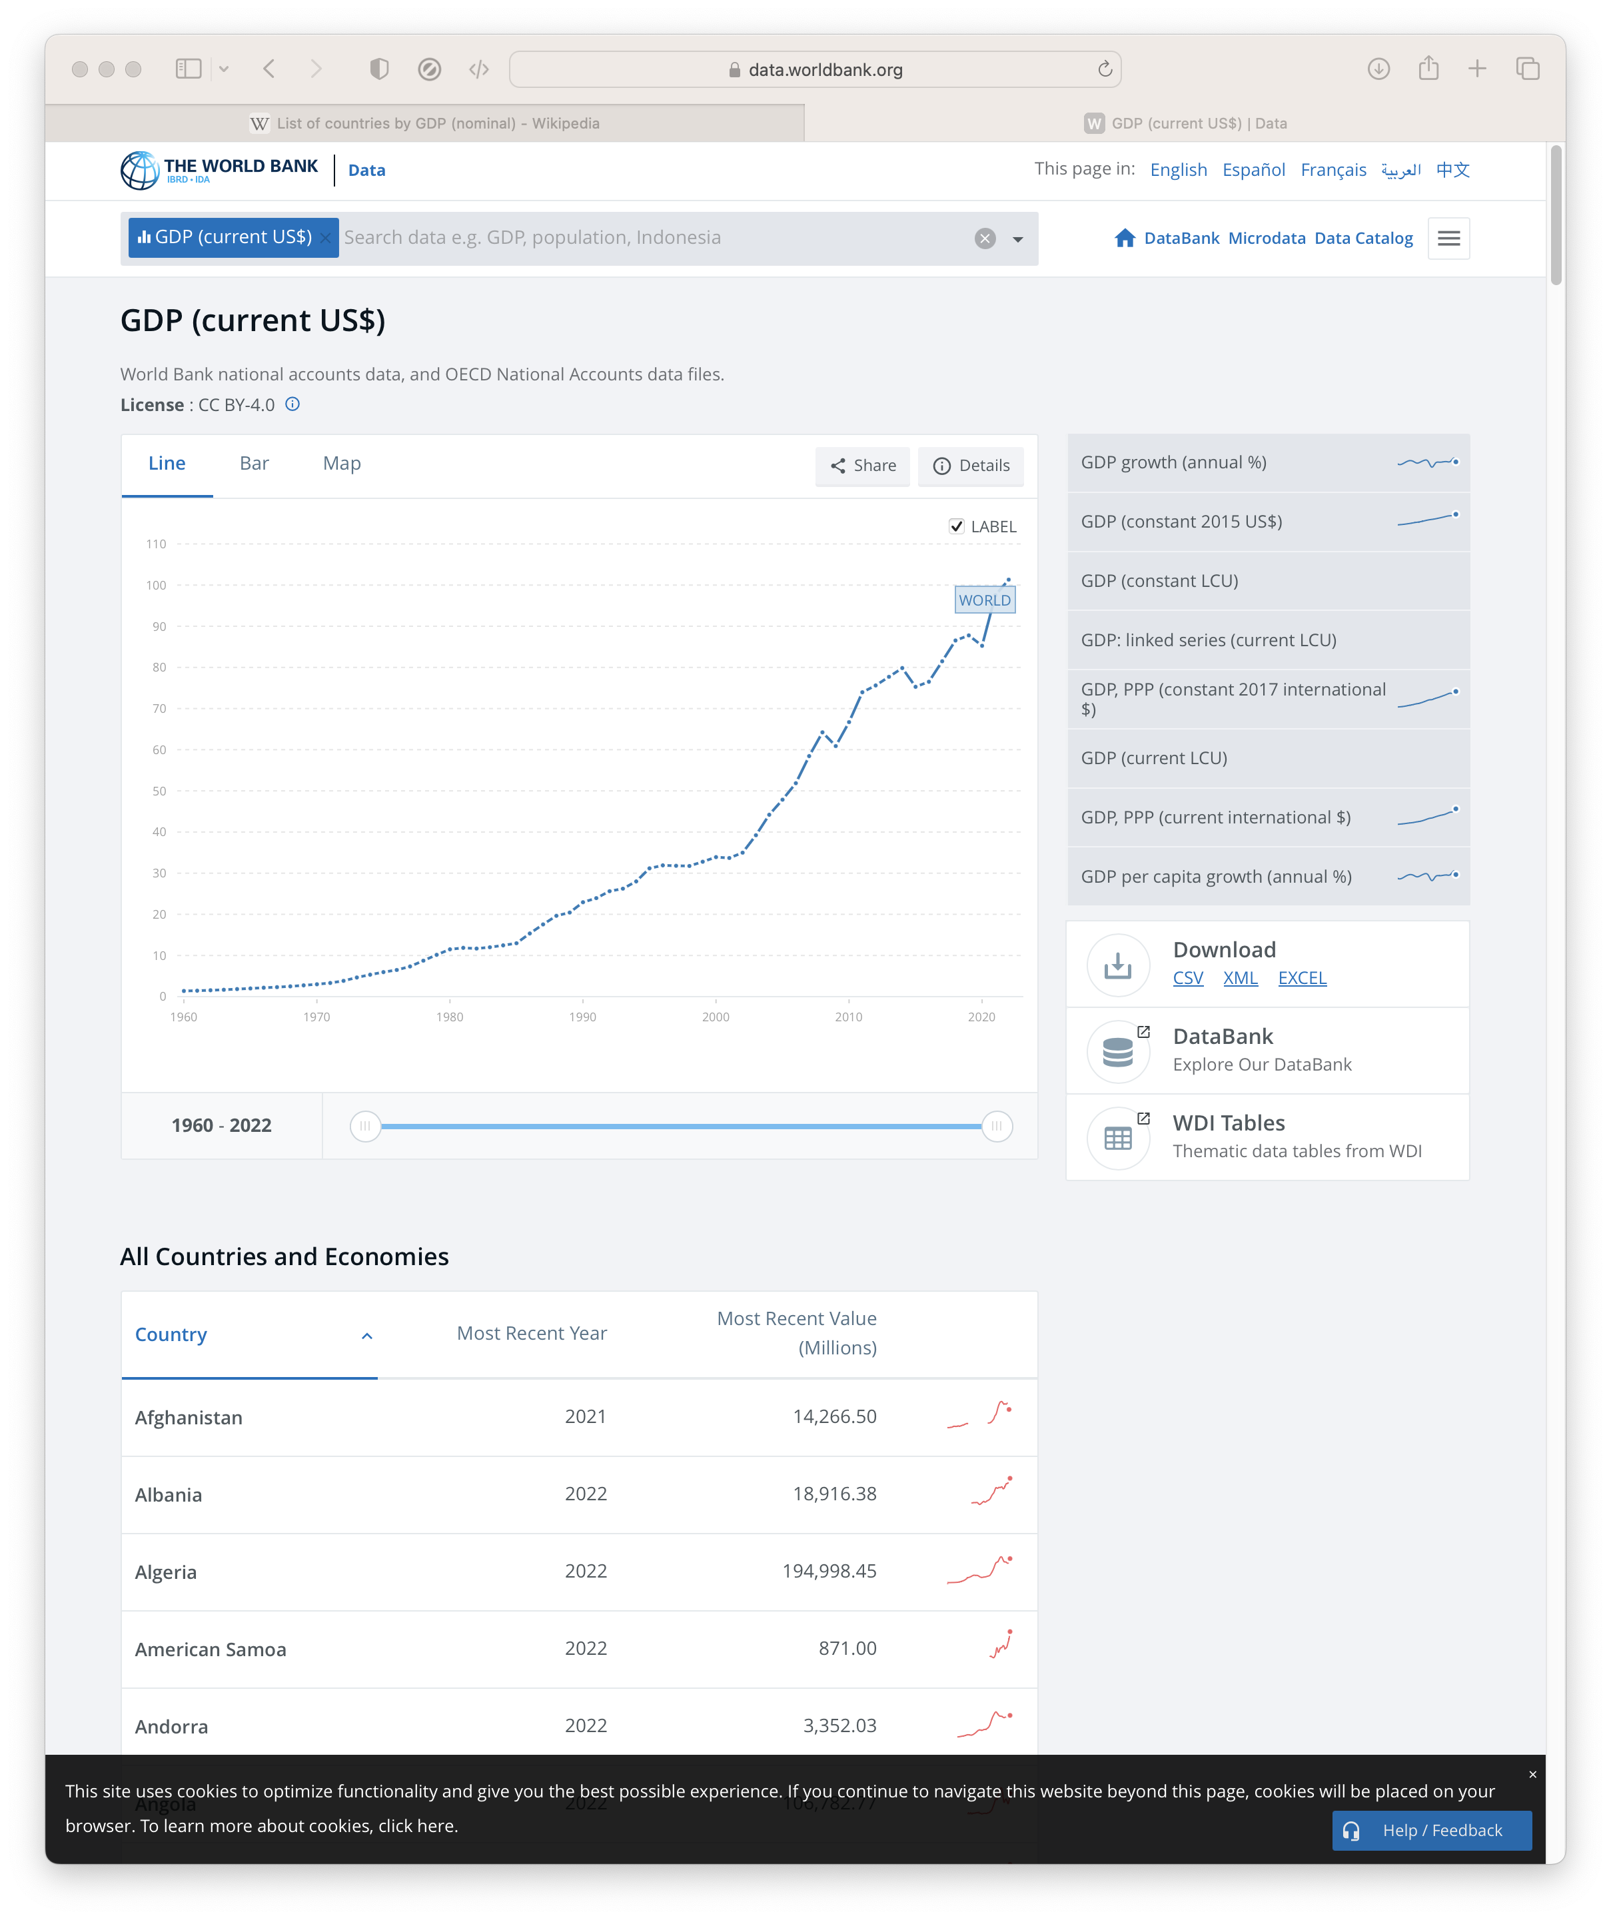
Identify the data needed.
You can scrape almost anything
… but scraping is most useful for hard-to-find data
You could scrape Wikipedia’s list of countries by GDP…
… but there’s no point
If you can just download the data

Slide 11
Look around.
Search the web for exactly the data you want
Try to find a download first
Our Example
Table of G7 Meetings
✓ Excel/CSV Unavailable
✓ Table Available

Slide 12
Scrape the data.
Scraping data from tables on webpages is easy with Python
We can use Pandas, which we have already seen today
pd.read_html(url)
(Loads every table from a webpage)

Slide 13
Scrape the data.
To read all the tables, we point url to our example page
url = "https://en.wikipedia.org/wiki/G7"
tables_from_webpage = pd.read_html(url)
Which makes a list of every table.

Slide 14
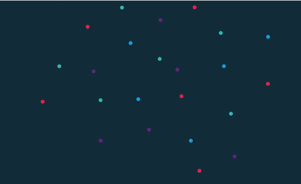
Code-along.
To see this in action
Go to tinyurl.com/4x67jd59
Run through the guided notebook

Slide 15
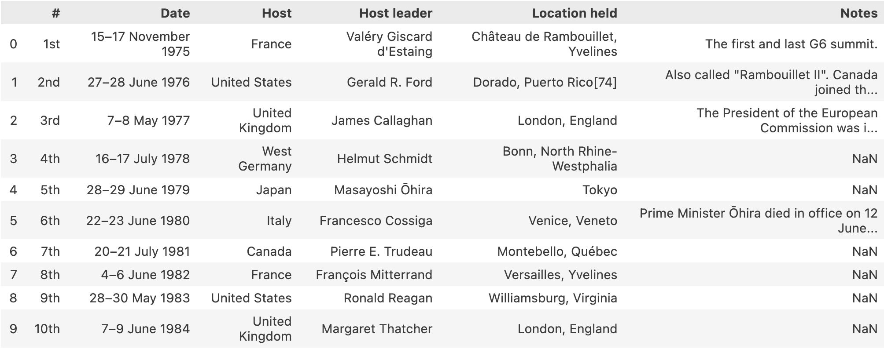
Scrape the data.
The list of G7 meetings, our target, is the 3rd table on the webpage:
tables_from_webpage[2]
Notes:
Reminder: Lists start at 0

Slide 16
Scrape the data.
The list of G7 meetings, our target, is the 3rd table on the webpage:
tables_from_webpage[2]
Notes:
Reminder: Lists start at 0

Slide 17
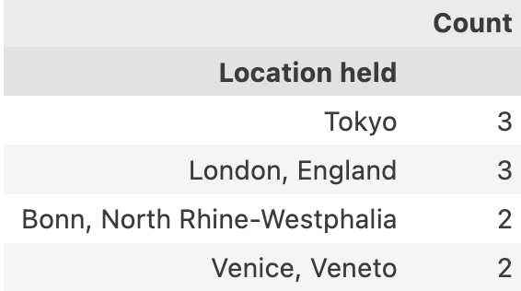
Cleaning and Visualising.
We have a messy table of data
Let’s clean it up to answer
‘What’s the most popular location for G7 meetings?’
(Full Code in Notebook)
Notes:
Reminder: Lists start at 0

Slide 18
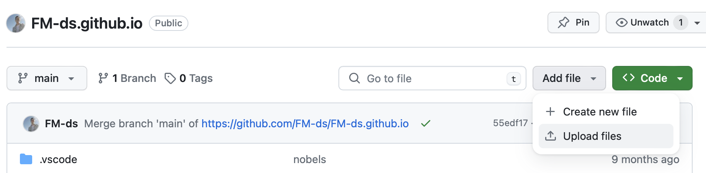
Cleaning and Visualising.
After saving our table and uploading to GitHub, we can use it in Vega-lite
Notes:
Upload the CSV to your github

Slide 19
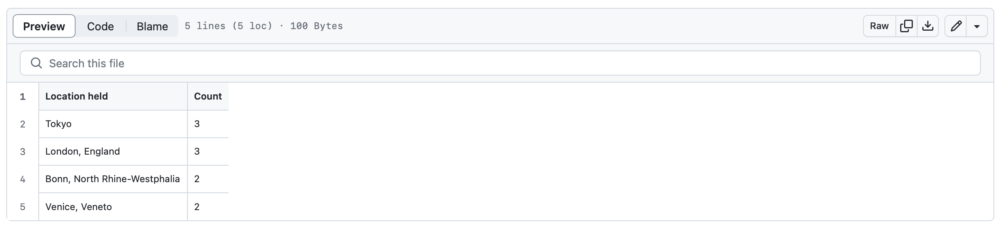
Cleaning and Visualising.
After saving our table and uploading to GitHub, we can use it in Vega-lite
Notes:
Find the file and click raw

Slide 20
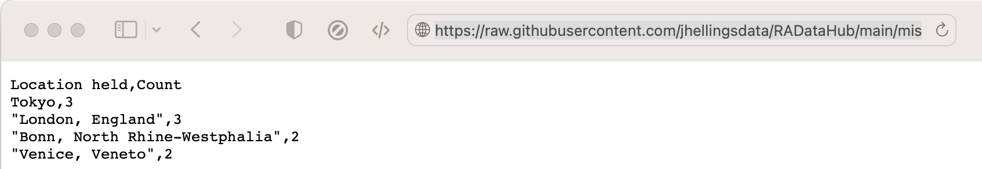
Cleaning and Visualising.
After saving our table and uploading to GitHub, we can use it in Vega-lite
Notes:
Copy the link

Slide 21
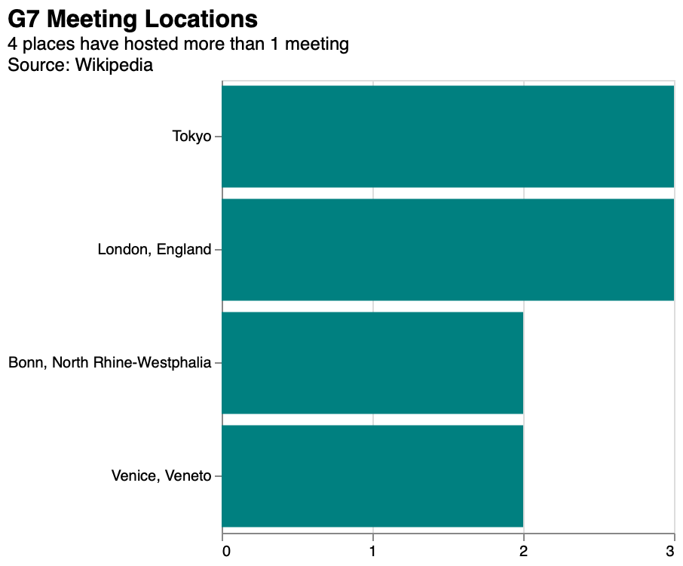
Cleaning and Visualising.
Linking to our data, we can use it in a chart
Notes:
Copy the link

Slide 22
Session 5. Scraping the HTML source (advanced)
[20 min]

Slide 23
Scraping HTML Source.
Scraping tables is easy but sometimes we want data that isn't nicely formatted
Instead, we can extract data by searching the HTML
Everything is defined in the HTML, we just have to find it

Slide 24
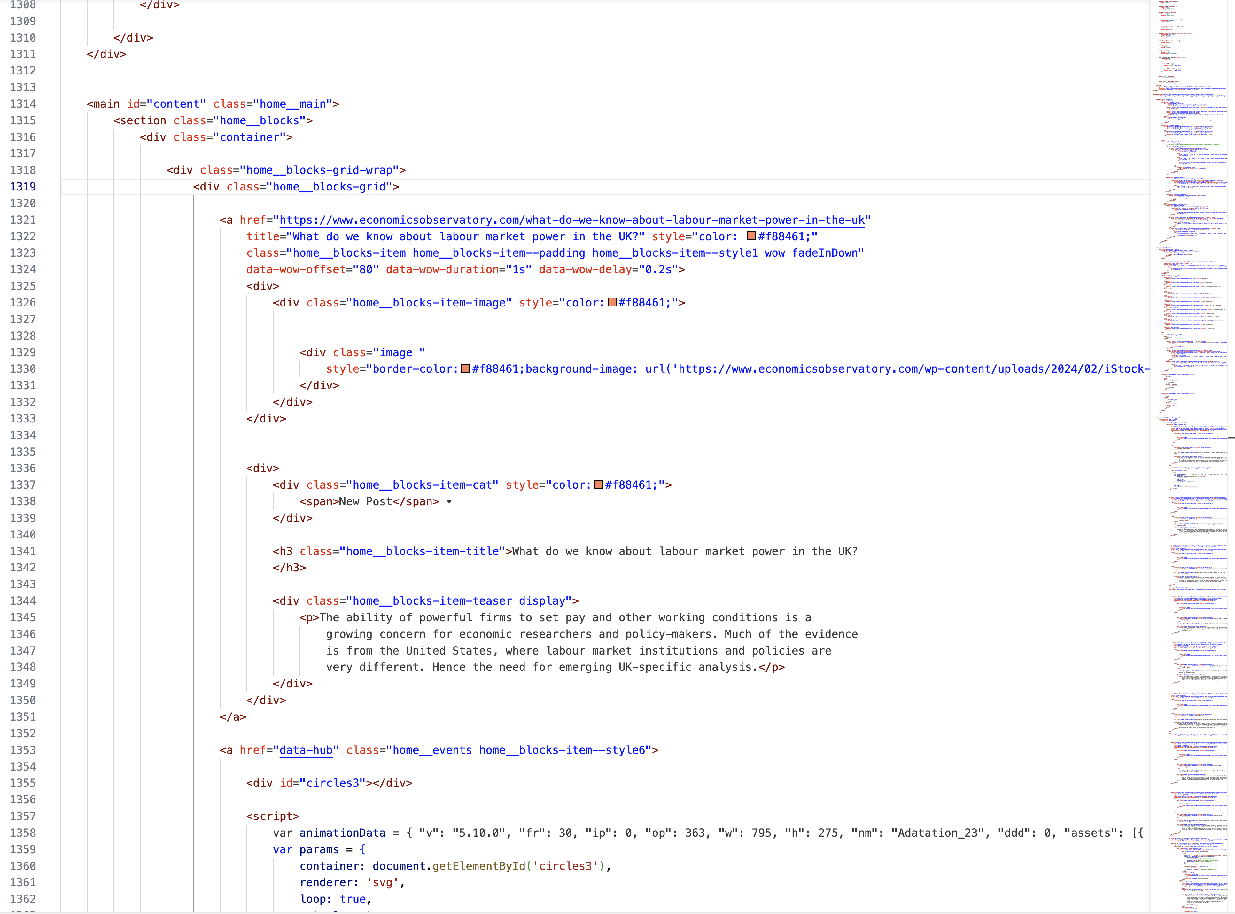
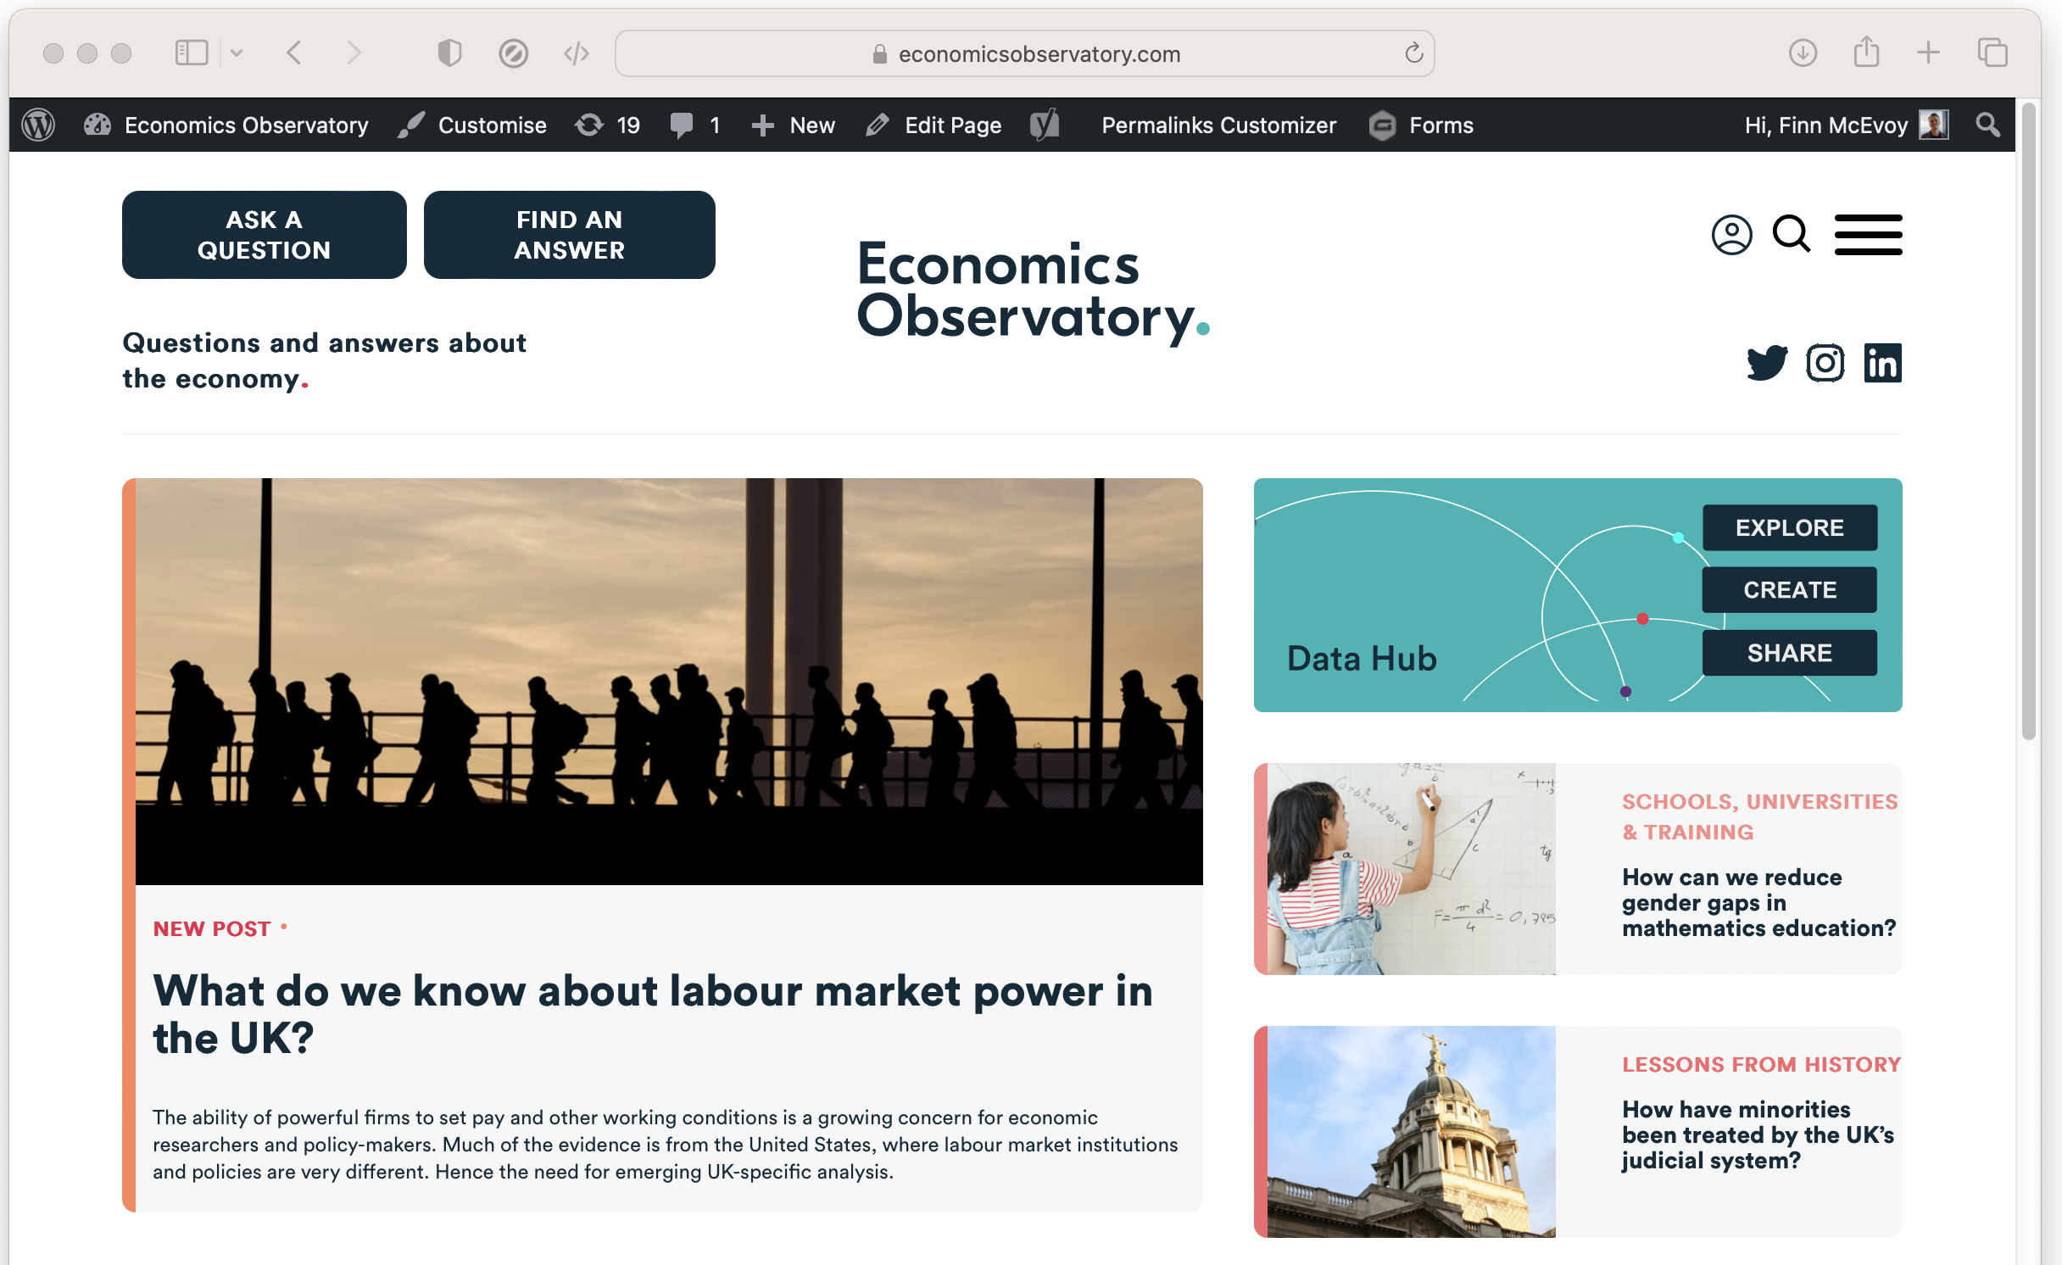
Scraping HTML Source.
For example, we can scrape ECO. headlines and tag-lines
by parsing the HTML.
Notes:
On this page, the HTML (2700 lines long!) defines the page we see

Slide 25
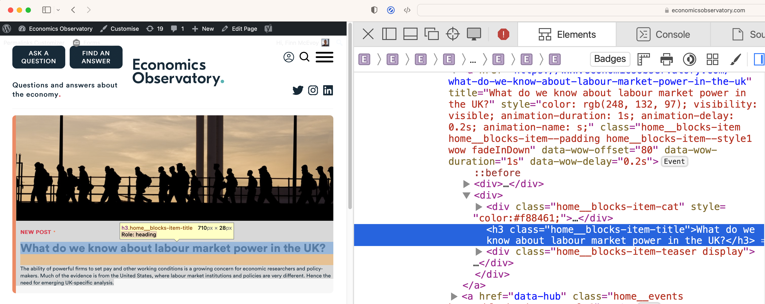
Scraping HTML Source.
We determine how the target data is defined using ‘inspect-element’
We see titles have a class “home_blocks-item-title”
Notes:
On this page, the HTML (2700 lines long!) defines the page we see

Slide 26
Code-along.
To see this in action
Go to tinyurl.com/4x67jd59
Run through the guided notebook

Slide 27
Learn more.
In this session we have tried basic data scraping with Pandas and seen advanced scraping with BeautifulSoup
There’s still much more to learn
Choose your own projects (how can you make your job easier?)
Try bigger projects (scrape 100 pages, not just 1)
Try advanced tools (e.g. Selenium)
Notes:
On this page, the HTML (2700 lines long!) defines the page we see

Slide 28
Learn more, responsibly.
Rate-limiting: avoid making too many requests at once
Ethics: Ensure your scraping activities do not harm the website's operation
Data Privacy: Be mindful of personal data collection. Comply with relevant data protection laws (like GDPR).
Notes:
On this page, the HTML (2700 lines long!) defines the page we see

